Slide 1
Redefining Cancer Treatment
By:
Gaurav Pandey
Msc (Big Data Analytics)
B1930035

Slide 2
Problem statement
This problem of “medical treatment on cancer” is generally faced a lot in medical industry that is the institution named MEMORIAL SLOAN KETTERING CANCER CENTER launched the dataset opensource and asked the aspiring data scientists to provide their solution using different- different techniques and models for the concrete solution of this problem.
The problem is there is a lot of manual work is happening by the researchers and they wanted to replace it by using the machine learning techniques.
In simple words, every human body have some sort of gene’s and genetic sequence in their body and if your genetic sequence lead to any variation due to various reasons like smoking, hereditary etc.

Slide 3
Contd…
Those variations will lead to the cancer in human body but definitely it is not always the case that all the tumours lead to cancer but it is most times leads to cancer.
we have 9 classes provided which means that if some sort of gene gone through with some sort of variation then it will lead to one of those classes
The thing here is that we do have genes, variations and classes. So, the problem faced by the pathologists are that there are so many genes and variations occur in the body and to understand the type of variations there are research papers available to them which they need to refer whenever any variation occur amongst the gene and going through with all the research papers takes so much time and efforts and because it is an issue of medical so the minimal mistakes are acceptable.
To make the work easy for pathologists we are going to take help of the machine learning for classification of these gene’s and variations with respect to the relevant classes.

Slide 4
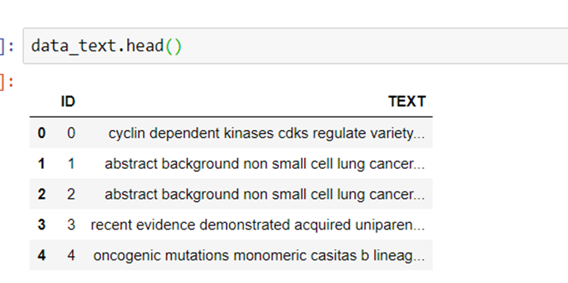
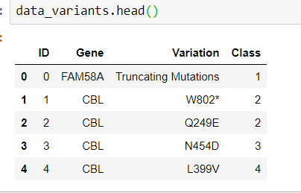
DATASET
The dataset we have been provided to solve the problem stated above would be in two parts:
Variant file- This contains the information about the genes, variations and the classes. These are the features present in the datafile.
Text data file- This contains the information regarding the research papers available to identify the type of cancer.

Slide 5
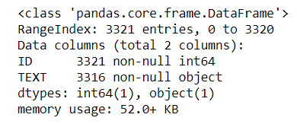

Contd…
In class column, we have 9 unique no. of classes
Now, the problem we are going to solve is that we have gene, we have variation and we have research papers (in text file). By using these we need to predict the class.
But there are some missing values in the text data file, we need to take that into consideration as well

Slide 6
Methodology
Since, we are dealing with the problem where errors can be very costly we need to be very careful while dealing with this kind of problem. This can be proven costly to researcher as well as patient.
So, here we have life and death situation here that is to contain these errors we would like to have results for each class in terms of probability.
In terms of probability means, for example, we have

Slide 7
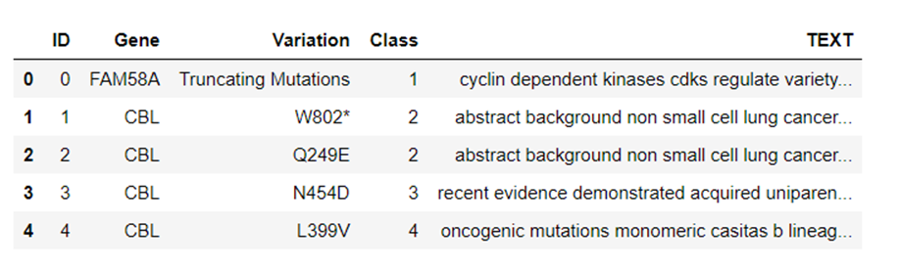
Experimental Evaluation:
Dealing with the text data:
Now, form one perspective this is very important for the researcher’s point of view but here this report we cannot directly feed to the ML-based algorithm. So, here first we need to cleanse the data like we do in the NLP.
In cleansing now what needs to be removed/ replaced and what to keep so that we can smooth the data as per our requirement without losing any information.
Remove the double spaces and tabs present in the dataset.
There are so many unnecessary numbers present in the dataset which we do not need right now for our processing the data.
There are so many words in the data set where same words use in different format like gene and Gene.
There are so many stop words present in the text data file like an, a, the etc…
Now, after cleansing we are going to merge our dataset with the variants file, there is common component needed to merge and that common component here is “ID”.

Slide 8
Contd…
Splitting the data
General procedure we use in machine learning is to simply divide the data into training set and testing set and then create model on training set and test it on testing set but sometimes this is not a good thing to do because when we play with the things called hyperparameter tuning then these things may cause a problem in a way that we may be become more dependent on the testing dataset. The result comes out with the test dataset and we start looking for accuracy on training dataset this creates the dependency on the test dataset.
In order to handle that we come up with the validation dataset, here we divide the dataset into 3 parts rather than two parts.
Here, those three parts are:
Training set
Cross-validation set
Testing set

Slide 9

Contd.
Checking the distribution of data
After splitting it is very important that we do notice that distribution of the data happened properly because if the distribution does not happen properly many kinds of problem can occur like:
Here we have 9 classes, suppose class 1 components are stayed in the training dataset and there is a chance that they haven’t gotten into the cross-validation and testing set. If this happens then there is no way to bringing in and verify that whether my model is to bringing the class 1 is good or not.
It can also happen that suppose class 7 components we have here is not much present in the training set, so if that happens then we do not have much information in training set to train our model and get accurate predictions because not much patterns available to study or to learn from the training set.

Slide 10
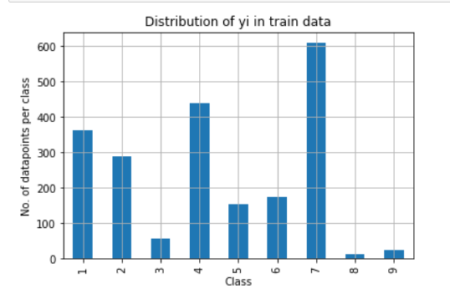
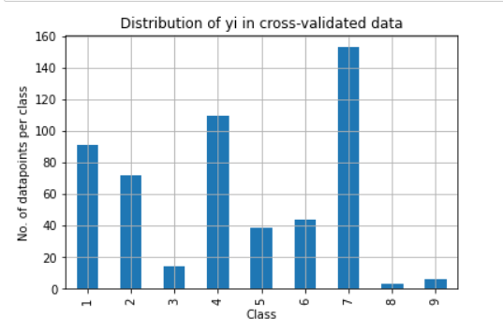
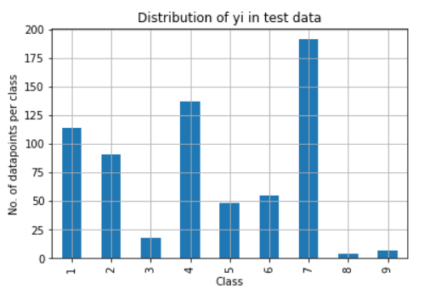
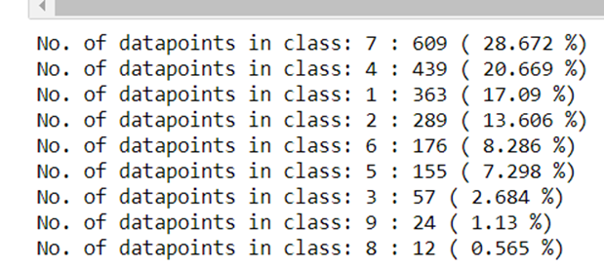
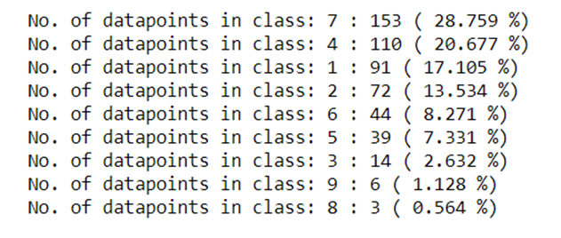
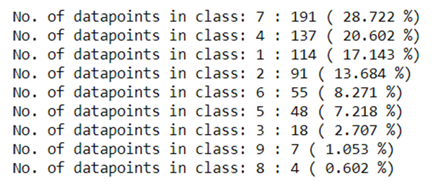
Contd…
Visualization of distribution:

Slide 11

Accuracy
We are going to check accuracy via log-loss.
A perfect log-loss would have 0 log-loss
There is evaluation for log-loss in two types:
Binary classification
Multiclass classification
Since, we have the problem statement of multiclass classification so we are going to talk about it a bit.
Formula:
To check its model accuracy, it is similarly work like our previous binary classification. The difference is that there we just had 2 classes and here we have 9 different classes to classify. Else the results will be provided in the similar manner.
In our case for each row we have some probability from our model and from that probability we decide that where which class lies more importantly log-loss plays that our model’s prediction is how much accurate for the classification here in the project.

Slide 12
Random Model
As I have explained previously that we are using the log-loss function in our report and log-loss function can be any value between 0 and infinity.
So, it is very difficult to say that which log-loss is better or which is worse. For ex- in our model we get log loss value of 1.5. How could we tell that this 1.5 represents the better model or the worst?
Hence, for comparison I am going to create a random model which also would be the worst model which is completely created by the random numbers. So that we can compare our model with this worst model.
What I have observed from my random model?
I simply run for the cross-validated data and test data and got the following log-loss value:
Cross-validated data: log-loss= 2.465
Test data: log-loss= 2.436

Slide 13
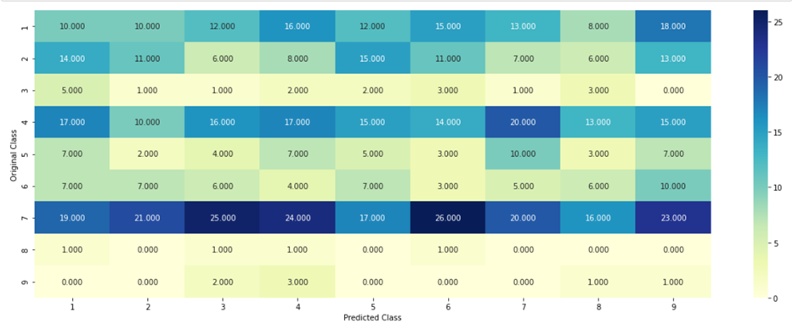
Contd…
Accuracy by confusion matrix and precision matrix

Slide 14
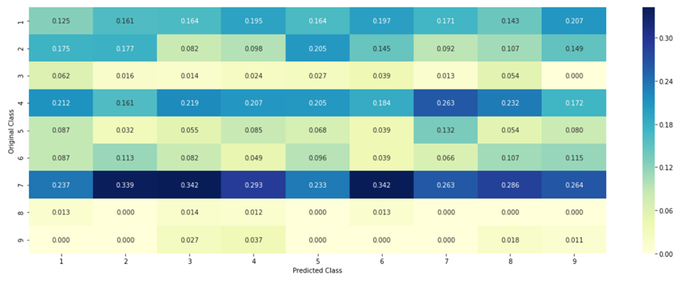
Contd..
Precision matrix

Slide 15
Dealing with categorical features in data frame
Now, here the problem arises that how to deal with the categorical variable present in our dataset. Because we cannot feed the categorical variables directly to our machine learning algorithm.
For example, in our dataset we have 4 features where 3 are independent and 1 is dependent. Class is dependent and gene, variation and text are independent. Here gene column is categorical so we need to assign some value to this column to feed this data to ML algorithm.
There are two methods to do that transformation would be as followed:
One-hot encoding method
Response encoding

Slide 16
Contd…
One-hot-encoding
It is a method in which we create extra columns with the name of unique values is our categorical variables. And we create sparse matrix from that.
Like here in our dataset we have 229 unique genes which means we need to create a sparse matrix like structure adding the 229 new columns.
There lies problem with the one-hot encoding method i.e., it increases the dimensionality of the dataset. Few algorithms have big trouble with this type of high dimensionality of the data, specially trees kind of algorithms like Random forest and decision tree (CART) etc.
Response encoding
Now, I am going to explain how this works in contrast of this gene feature in our dataset.
As we know we have 9 classes in our dataset and unique values of genes associated with the classes as we have shown in the code.
For each class we create a column and assign probabilities to the classes. Like probability of gene being in a class 3 given that the gene is BRCA1(name of the gene).
Similarly, we deal like this with all the gene values and assign some kind of posterior probabilities to them.

Slide 17
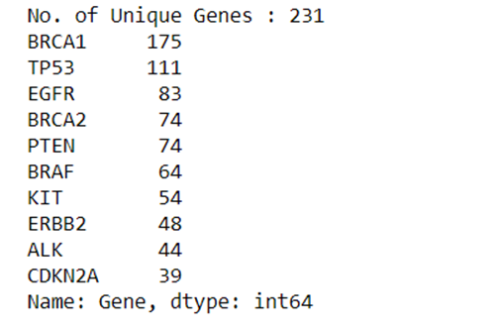
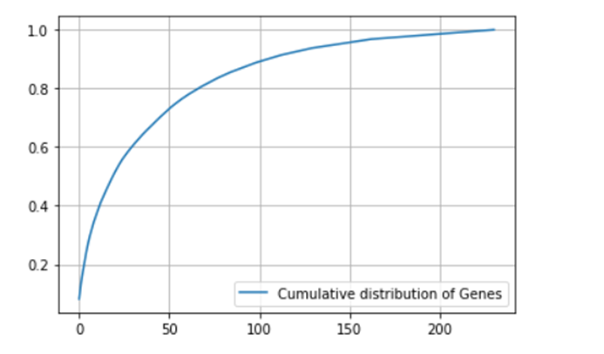

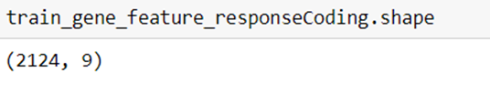
Contd….
Visualization of Gene feature

Slide 18
Modelling:
Naïve Bayes
Here in this model we are going to use naïve bayes classifier for multinomial models.
The multinomial Naive Bayes classifier is suitable for classification with discrete features (e.g., word counts for text classification). The multinomial distribution normally requires integer feature counts. However, in practice, fractional counts such as tf-idf may also work.
But I have tried to perform modelling via naïve Bayes on my dataset. And it has shown me some great results with one hot encoding method.
It has shown higher interpretability amongst the entire dataset.
Here, are some best results we get from the naïve Bayes model:

Slide 19
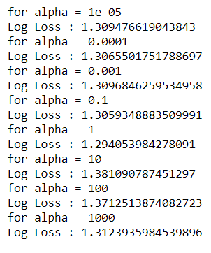
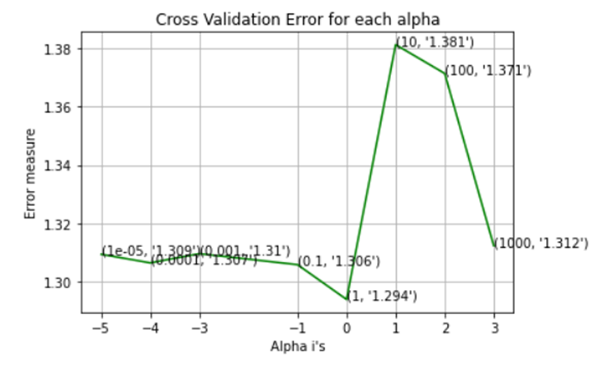
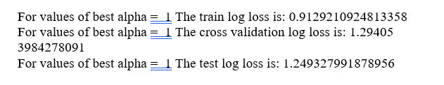
Contd…
Outputs:

Slide 20
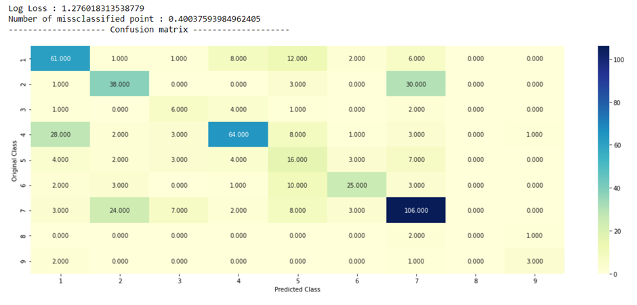
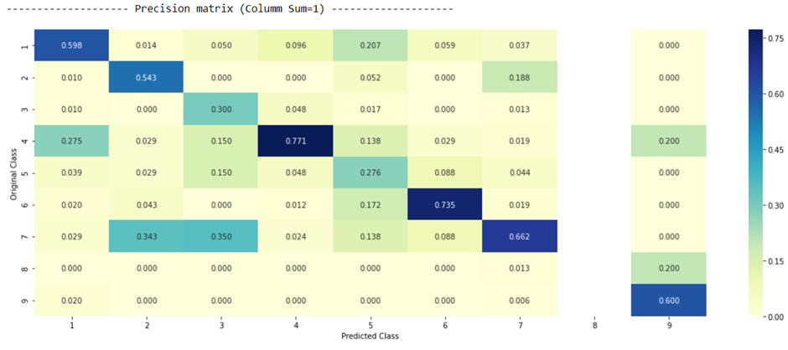
Contd….
Accuracy of naïve bayes
As you can see in the above confusion matrix diagonal elements in the matrix are performing quite well. Whereas, there is some confusion in happening in (2,7) and (3,7) and we can recheck that in precision matrix as well plus there is an entire column which is shown white here i.e., 8th column there reason behind that may be because of insufficient dataset present about the class 8 in the training dataset.

Slide 21
Contd…
KNN
I have done the similar thing to build a model as I had done above the only difference is this time, I am going to use response encoding method because KNN does not perform better with the high dimensionality in the dataset. I had used one-hot encoder as well to run but the problem I have faced that it was taking too much ram memory and the provided results are the worst, I can say worst than my random model.
In naïve Bayes we do have quite good interpretability of our text dataset but in KNN this is one more demerit that interpretability is not so good we do have interpretability but it will be having at very minimal level. So, you should not call it as a interpretable model that’s the issue with the KNN-model.
Obviously, there is difference between the code and method but the pattern I am going to follow the same as we have done above so that later on, we can compare these two models as well as the other models I am going to build further.
Similarly, I have selected the values of hyperparameter i.e., again alpha but this time my nearest neighbour would be different because here the regularization would be dependent on K, that should I look at 5 nearest neighbours, should I look at 11 nearest neighbour etc…

Slide 22
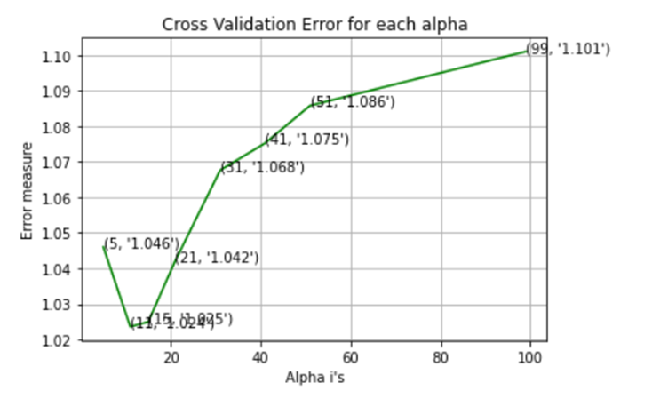
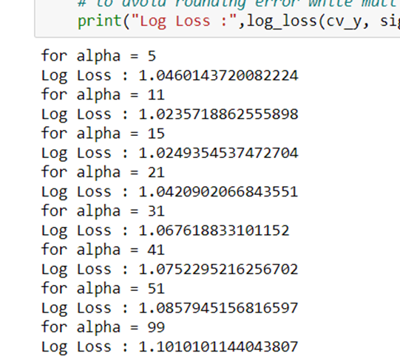
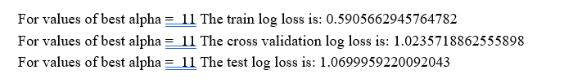
Contd..
Outputs

Slide 23
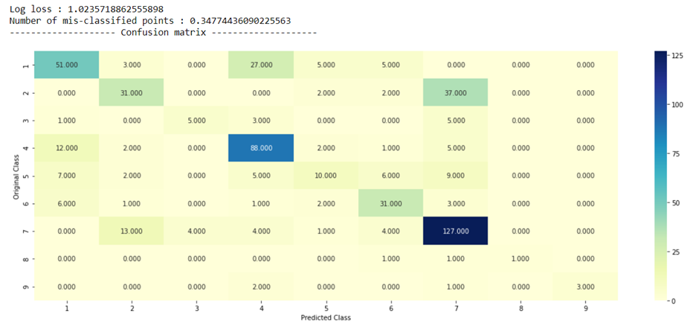
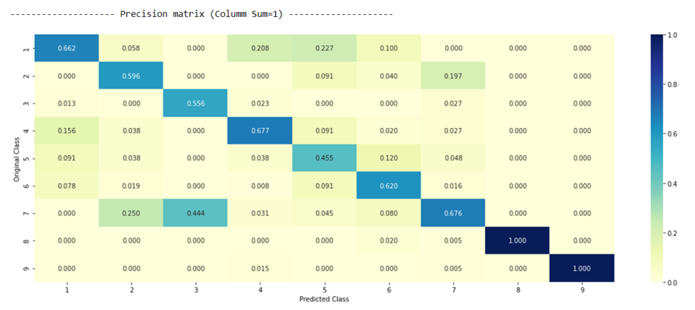
Contd…
Accuracy of KNN
Interpretation of the above results:
Again, if you look at the diagonal elements the entire model is working perfect the only problem I can see here that diagonal element of 8 and 9 in precision matrix have the value 1 and the rest of the column is 0 which shows that column 8 and 9 does not have sufficient data in regards of class 8.
Similarly, here as well there is some confusion in happening in (2,7) and (3,7) and we can recheck that in precision matrix as well plus there is an entire column which is shown white here i.e., 8th column there reason behind that may be because of insufficient dataset present about the class 8 in the training dataset.
After checking the accuracy I have done one more thing with this KNN model that is testing the points, like I took 1 of the query point where I am getting the wrong result and due to insufficient information in training dataset.

Slide 24
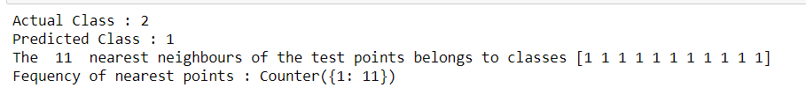
Querying the classified points results

Slide 25
Contd…
Logistic Regression Model (with balancing)
Now, we are gonna follow the same procedure as we have done above just this time while going with the logistic regression model this time I am going to balance all the class because as you have seen in the above models that there is some misbalancing happening in the class 8 and class 9.
Again, first selecting the hyperparametric values i.e., α. Finding the best alpha using the log-loss.

Slide 26
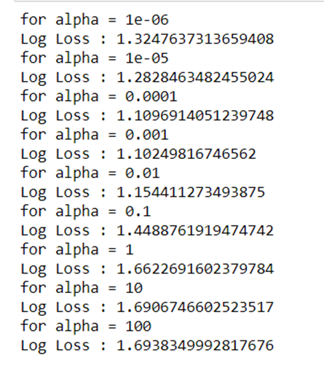
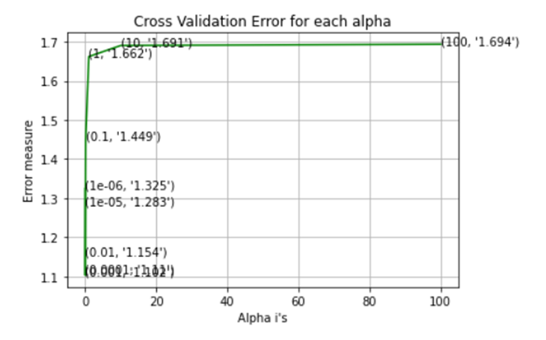
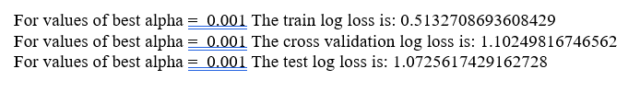
Contd…
Outputs

Slide 27
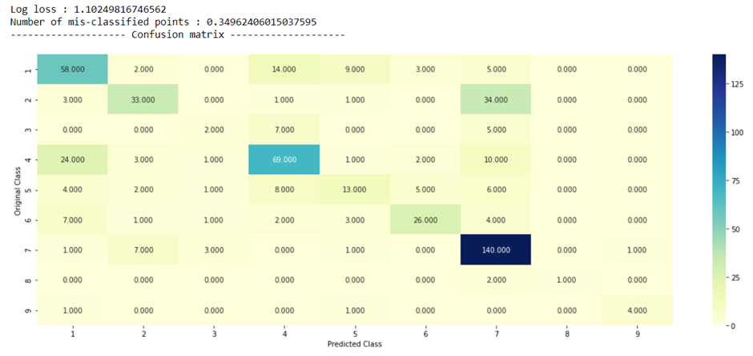
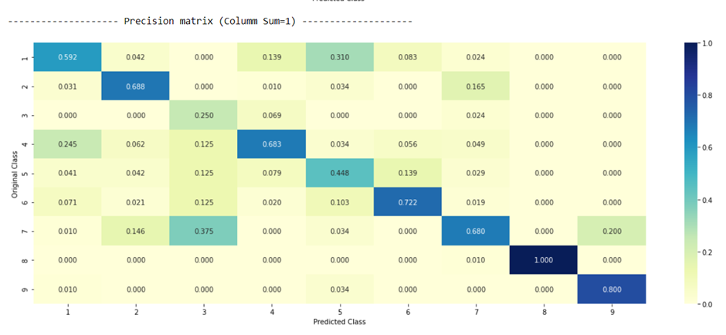
Contd…
Accuracy of logistic regression with balancing
Here not much change we can see here with balancing all classes still the same problems came up with the class (2,7). Not much have been change with balancing all the classes the interpretability is same as we have done for the above models.
Now, the one very good thing with the logistic regression is that it works very good with the interpretability of the model because it considers the weights and coefficients and all those things.

Slide 28
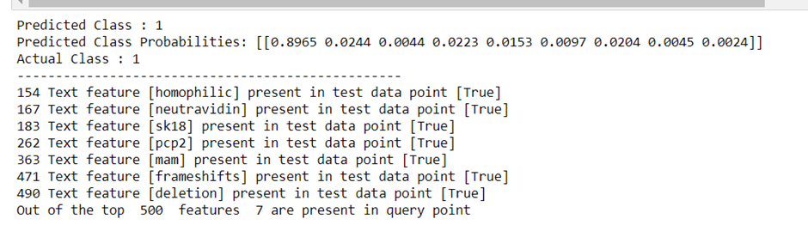
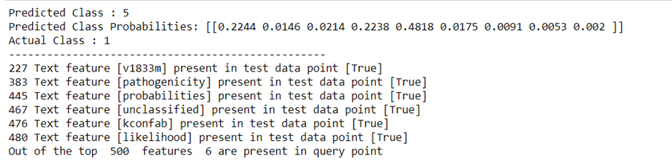
Contd….
Querying the classified points results

Slide 29
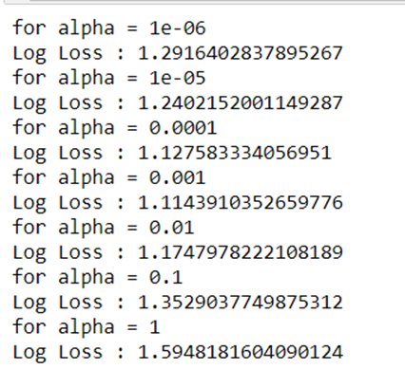
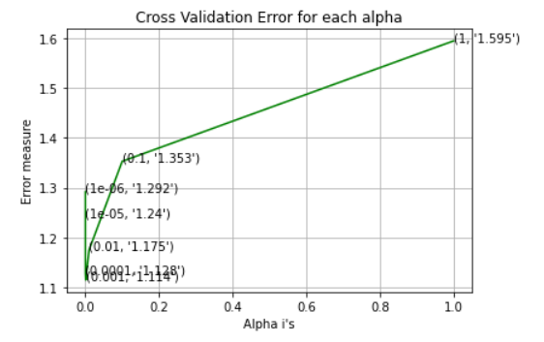
Contd…
Logistic Regression Model (without balancing)
Now, we are going to do same thing as we have done in the logistic regression model above just there is only one difference in this model is that this time, we are not going to balance the classes here, rest of the procedure will be similar.
Again, first selecting the hyperparametric values i.e., α. Finding the best alpha using the log-loss.

Slide 30
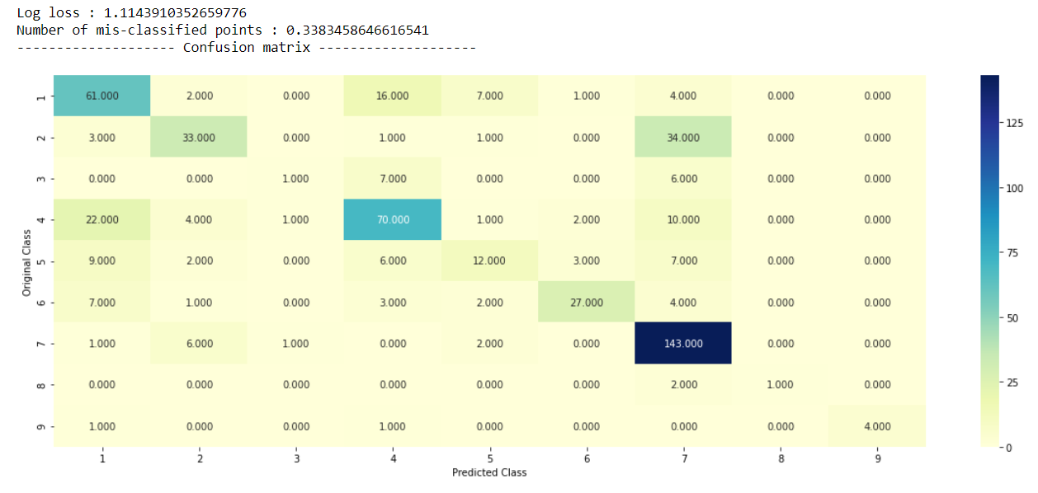
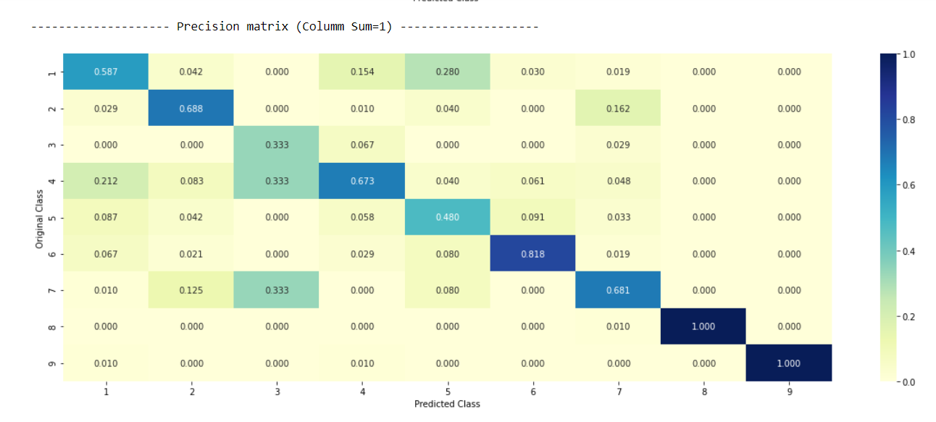
Contd…
Accuracy of logistic regression without balancing
It is very strange for me to see here that the miss-classified points are less in the same model without balancing in comparison to with balancing but we can also here say that balancing is not a good choice always sometimes model performs better without balancing as well and our case is the live example here.
Now, I am going to comment about the interpretability of this model

Slide 31
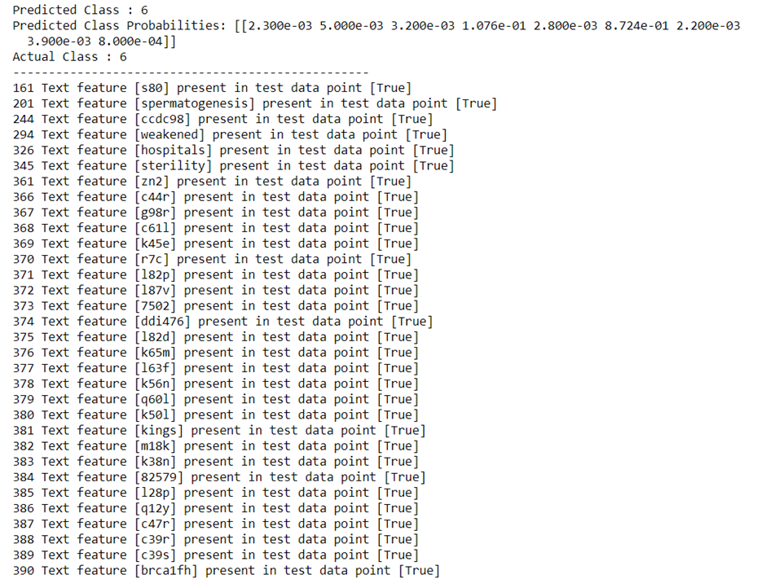
Contd…
Querying the classified points results
Here we have done with the correct where I got the predicted and actual class is same. I have done nothing played with the test_point_index in the code, it is very similar to bias-variance tradeoff just take control over the biasedness and variability and you’ll get the best results otherwise it may lead to the problem of overfitting / underfitting.

Slide 32
Contd…
Random Forest Model (one-hot-encoding)
Now, further moving to our last model i.e., random forest. This time I am going to choose two hyperparameters for random forest because hyperparameters include the number of decision trees in the forest and the number of features considered by each tree when splitting a node. These parameters would be maximum depth and our regularization parameter (i.e., α).
We will apply the same procedure that we did in the above models. We are going to find out the best hyperparameter with a minimal log-loss and then with respect to that hyperparameter we will find our log-loss for train-cv-test.
One more thing is that this model is generally works well with both the method i.e., one-hot encoding method as well as response encoding method. Let’s see how well did it perform with my dataset.
First, I am going with the outputs evaluated using one-hot encoding method:

Slide 33
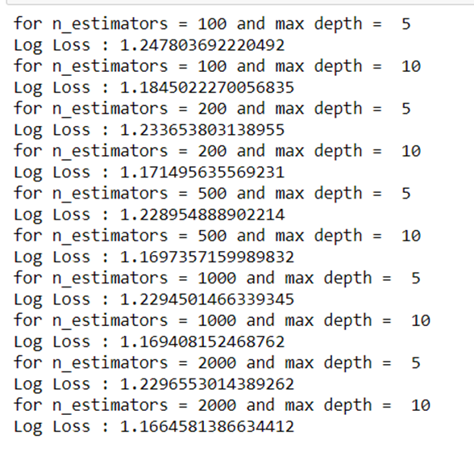
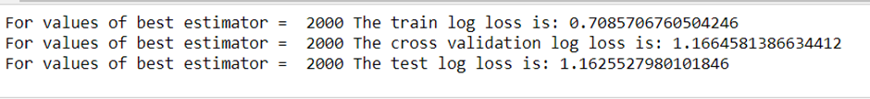
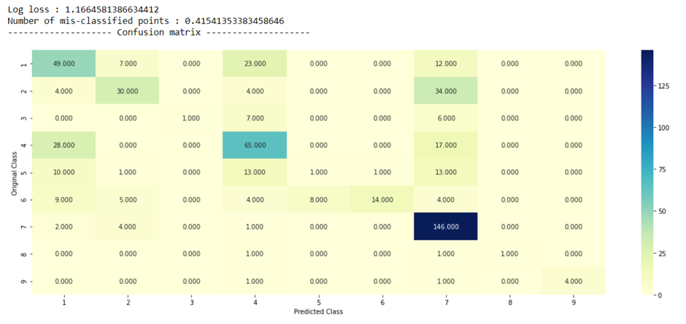
Contd…
Output

Slide 34
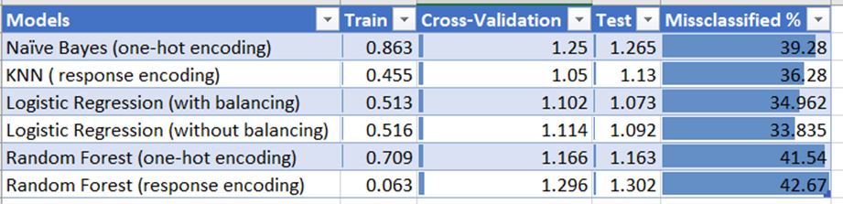
Conclusion
As per accuracy point of view this table clearly shows that logistic regression without balancing is the best model to consider where as for minimal log-loss point of view we go for logistic regression with balancing though there is not much difference in the prediction and precision. So, my suggestion would be the logistic regression without balancing.

